Slide 1
Manage and Monitor ML Models in Development, Test and Production Naresh Olladapu Developer Advocate IBM – ISL(India Software Labs) Email: nolladap@in.ibm.com

Slide 2
Overall Agenda
Introduction to AI Explainability and Bias Mitigation
IBM Watson OpenScale – Introduction and features
OpenScale Demo

Slide 3
Business stakeholders do not trust AI
60%
Without expensive Data Science resources handholding multiple AI models in a production application:
No way to validate if AI models are compliant with regulations and will achieve expected business outcomes before deploying
Difficult to track and measure indicators of business success in production
Resource intensive and unreliable processes for ongoing business monitoring and compliance
of companies see regulatory constraints as a barrier to implementing AI.
IBM IBV AI 2018
63%
cite availability of technical skills as a challenge to implementation.
- IBM IBV AI 2018

Slide 4
Current Model Risk Management practices work for existing statistical or rule-based models
Processes rely on regular interaction between validator and model developer
Easy to state and translate the regulatory guidelines into requirements
Validators can reproduce the results relatively easily
Current systems focus more on the documentation and governance aspects of model validation
Who developed the model?
What data was used to test it?
How did data and model evolve?
Who approved it?
Were approved techniques used?
Traditional statistical models are deterministic in nature or simpler to interpret and explain
Business rules
Descriptive statistics
Standard financial formulae
Excel spreadsheets
Linear regressions
Decision trees

Slide 5
Validation of AI models need to augment governance with proactive testing before and in production
Skills gap in order to test and validate ML/DL models
Probabilistic nature of ML/DL models do not provide a straightforward result for interpretation
Interpreting results and explaining to business managers and risk professionals require substantial time and effort from data scientists
Model metrics do not convey business KPI impacts
Tests to be run on ML/DL models differ from straightforward application testing
Model training data sets may not capture the range of data or combinations that could be encountered in runtime
Any change in input data – also known as Drift – can cause the model to make inaccurate decisions, impacting business KPIs
Training data may be cleaned to be free from bias but runtime data may induce biased behavior of model
Difficult to run what-if scenarios on probabilistic models without additional data sets

Slide 6
Model Development Cycle Challenges faced with ML/DL Models
Complexity and Assessment: Lack of knowledge of methods used by Model Developers /
Vendors along with inconsistent documentation and increased volume of model change.
Model Proposal
Model Development and Unit Test
Pre Implementation Review
(Pre-deployment Validation)
Model Approval
Ongoing Monitoring and Validation of Production Model
Tests to be run on ML/DL models differ from straightforward application testing
Drift: Any change in input data – also known as Drift – can cause the model to make inaccurate decisions, impacting business KPIs
Bias: Training data may be cleaned to be free from bias, but runtime data may induce biased behavior of model
Explainability: Traditional statistical models are simpler to interpret and explain
Missing Validation/Test Data: Model training data sets may not capture the range of data or combinations that could be encountered in runtime

Slide 7



Watson OpenScale
Validate and monitor AI models, deployed anywhere, to help comply with regulations, address internal safeguards, and mitigate business risk
Production monitoring for compliance and safeguards
Mitigate biased model behavior
Explain model decisions
Validate and control risk
Ensure that models are resilient to changing situations
Detect drift during runtime
Generate specific model retraining inputs
Align model performance with business outcomes
Actionable metrics and alerts
Notes:
Align model performance with business outcomes – “if you are thinking about launching an AI model into production, this is a no-brainer”
Ensure that models are resilient to changing situations – “if you are using AI to impact revenue, identify problems with business models or transform operations, you have to track changes in business inputs. Models need to keep up with it much faster than manual review/retrain recommendations”
Prove regulatory compliance and safeguards – “if you are in a regulated industry, there are existing regulations that automated decisions have to meet”; “new controls could get added to GDPR or new regulations being proposed may become a reality in the Digital age”. This will need to be done both during production and before deploying

Slide 8




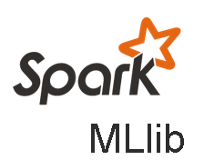

Open: Monitor and optimize models deployed on any model serve engine, beyond WML
Description:
Use Watson OpenScale to monitor models developed in a 3rd party IDE, open source framework and hosted in a 3rd party or private model serve engine
Model build/train frameworks
Value:
Automate and Operationalize AI wherever your AI and applications reside
Leverage flexibility and innovation of open source model building and training frameworks
Retain existing data and model pipelines deployed to support applications in production
Extend investments in skills and tools deployed as part of current data science and AI stacks
Model serving environments

Slide 9
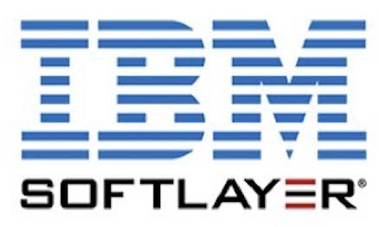
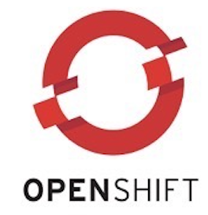



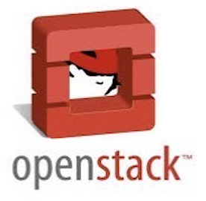
Multi-Cloud Deployment
Through IBM Cloud Pak for Data
Watson OpenScale can be deployed wherever organizations need it
IBM Public Cloud
IBM Cloud Pak For Data
Deployment through IBM Cloud Pak for Data provides a common installation and management experience wherever the offering is located
PUBLIC
PRIVATE
Maximize on cloud agility and economics
Cloud native, behind the firewall, client managed
Cloud Native Experience
Regardless of which cloud you choose, you get market leading Watson capabilities.
IBM Cloud / Watson and Cloud Platform / © 2018 IBM Corporation
9
9
Notes:
Today we are announcing a critical capability most organizations do NOT have today
Clarity and visibility into how organizations AI is built, run and managed in production deployments.
Watson OpenScale will major on operations around AI with trust & transparency leveraging the most common open frameworks and runtimes.
https://console.bluemix.net/catalog/services/ai-openscale

Slide 10

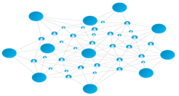




The IBM Data and AI Portfolio
Everything you need for enterprise data and AI, on any cloud
Talent & Skills
Pre-built Use Cases
Watson Applications
The AI Ladder
Prepare
Build
Run
Manage
Infuse
Watson
Knowledge Catalog
Watson
Machine
Learning
Analyze
Watson
Studio
Watson
OpenScale
Organize
Collect
A prescriptive approach to the journey to AI
Hybrid Data Management
Db2 Family
Data Ops & Governance
InfoSphere Family
Hybrid Data and AI Platform
Cloud Pak for Data
Hyperconverged System
10
Notes:
AI is all about the ability to build, deploy, catalog, and manage models, which is what IBM’s AI portfolio provides. It gives you the ability to:
BUILD models for making predictions. Watson Studio supports this.
DEPLOY to put custom models into production, in an application or business process. This is where the model starts to make predictions for the client’s business and it happens with Watson Machine Learning.
CATALOG for data discovery and activation. The Watson Knowledge Catalog allows users to access, curate, categorize, and share data and assets wherever they are.
MANAGE to operationalize and automate the management of models and tools across your business, with trust and transparency. IBM’s answer for that is Watson AI OpenScale.
All of this together is our AI portfolio that you can access on the private cloud, on the public cloud, on prem, or on desktop.
Watson Application Services are packaged applications that we bundle together to provide the user with AI in a box.
AI Open Source Framework: This is, without a doubt, the future of the market. We built our AI portfolio on open source to make it secure and managed so that our clients can put it to use without the risk or extra cost.
IBM Cloud Private for Data: IBM’s AI portfolio is designed to deploy on our unifying platform. This is our prescriptive approach—one platform, supporting a multi-cloud environment, that brings all of a client’s data and AI capabilities into one set of collaborative workflows and governance capabilities.

Slide 11
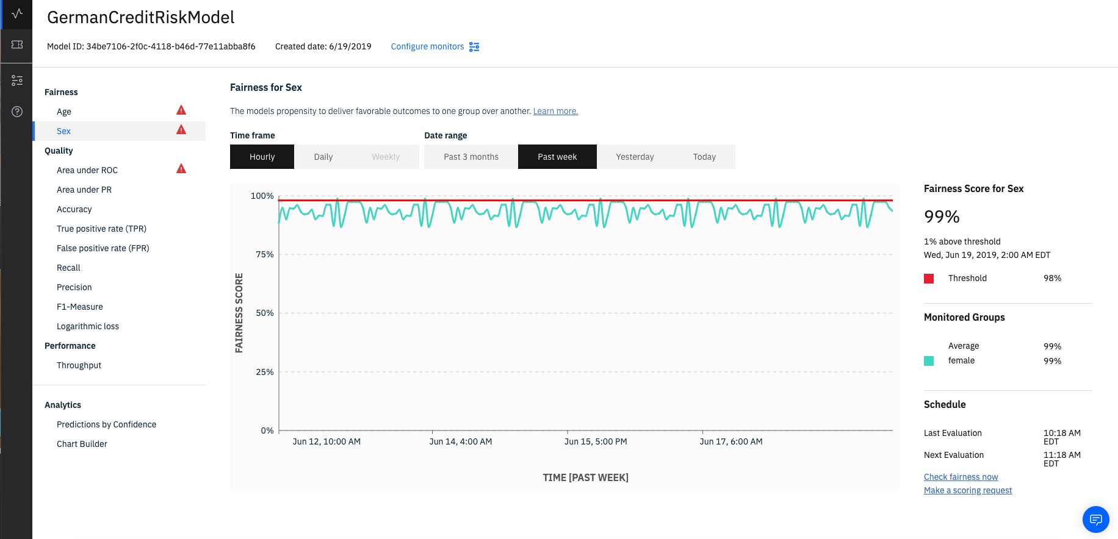
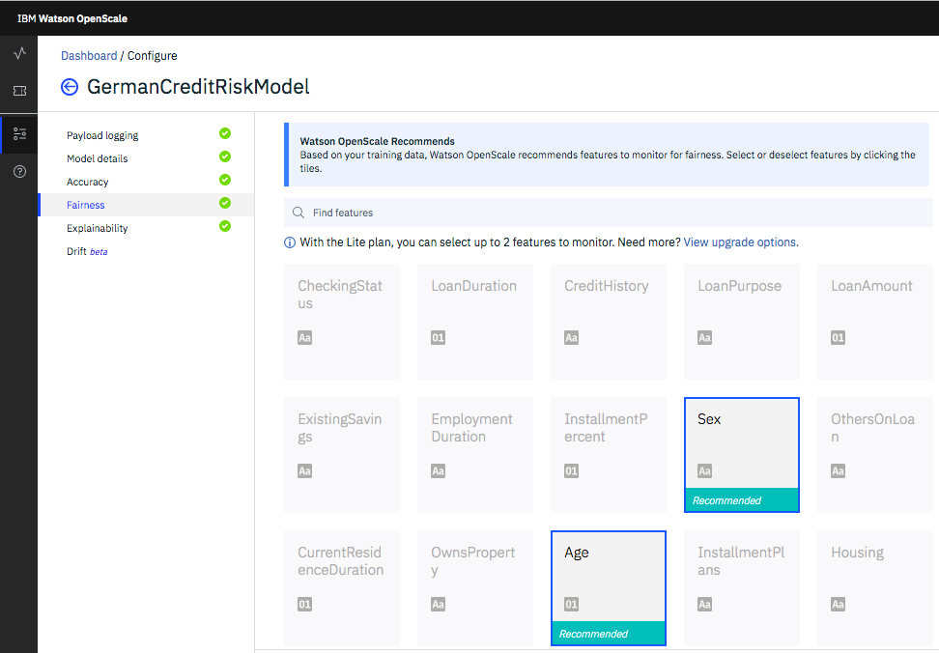
Bias Detection
OpenScale enables enterprises to enforce fairness in their model’s outcome by analyzing transactions in production and finding biased behavior by the model
It pinpoints the source of bias and actively mitigates the biases found in production environment
Value:
Automatically recommend common protected attributes to monitor during production
Detect biases in runtime in order to catch impacts on business applications and compliance requirements without time consuming, manual data analysis
Metrics and data to help data scientists further troubleshoot issues in data sets or models
Mitigate biases in runtime in order to enforce regulatory or enterprise fairness guardrails in real time

Slide 12
N
N data points
Perturbation
Perturbed
records scoring
X
Y
let’s say
No change in prediction
X points with
age < 24
Y
Y points with
age > 24
X
y
X
None got
favorable
outcome
0
All got
favorable
outcome
Y
N * 2
Original + perturb
data points
disparate impact ratio = ( 0 / X ) / ( Y / Y) = 0%
So, according to DI ratio, Model is highly biased.
X + Y
Y + X
But, is it really biased ??
age < 24
age > 24
Y
Y
favorable
outcomes
favorable
outcome
disparate impact ratio = ( Y / (X + Y) ) / ( Y / (Y + X) ) = 100%
You see.. model is not actually biased!

Slide 13
Bias Mitigation – Original Output
Bias Mitigation – De-biased output

Slide 14
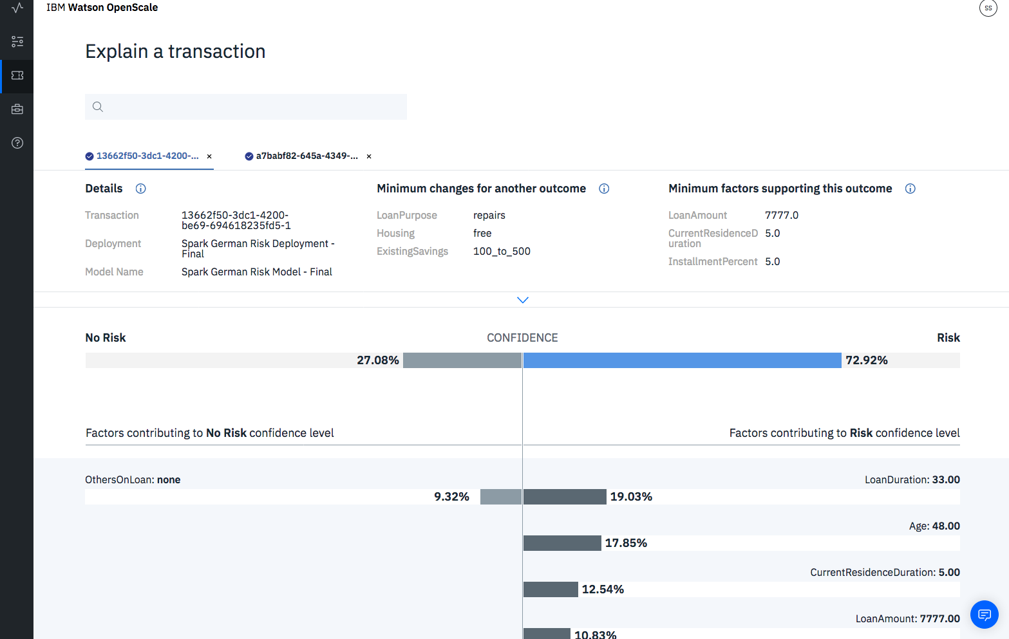
Explainability
OpenScale records every individual transaction and drills down into its working to explain how the model makes decisions
It provides a simple explanation that is user friendly and interactive
Value:
Explain individual transaction level decisions made by the model in run time, including details about most important attributes and their values in order to assist in compliance and customer care situations
Analyze individual transactions in a what-if manner in order to understand how model behavior will change in different business situations

Slide 15
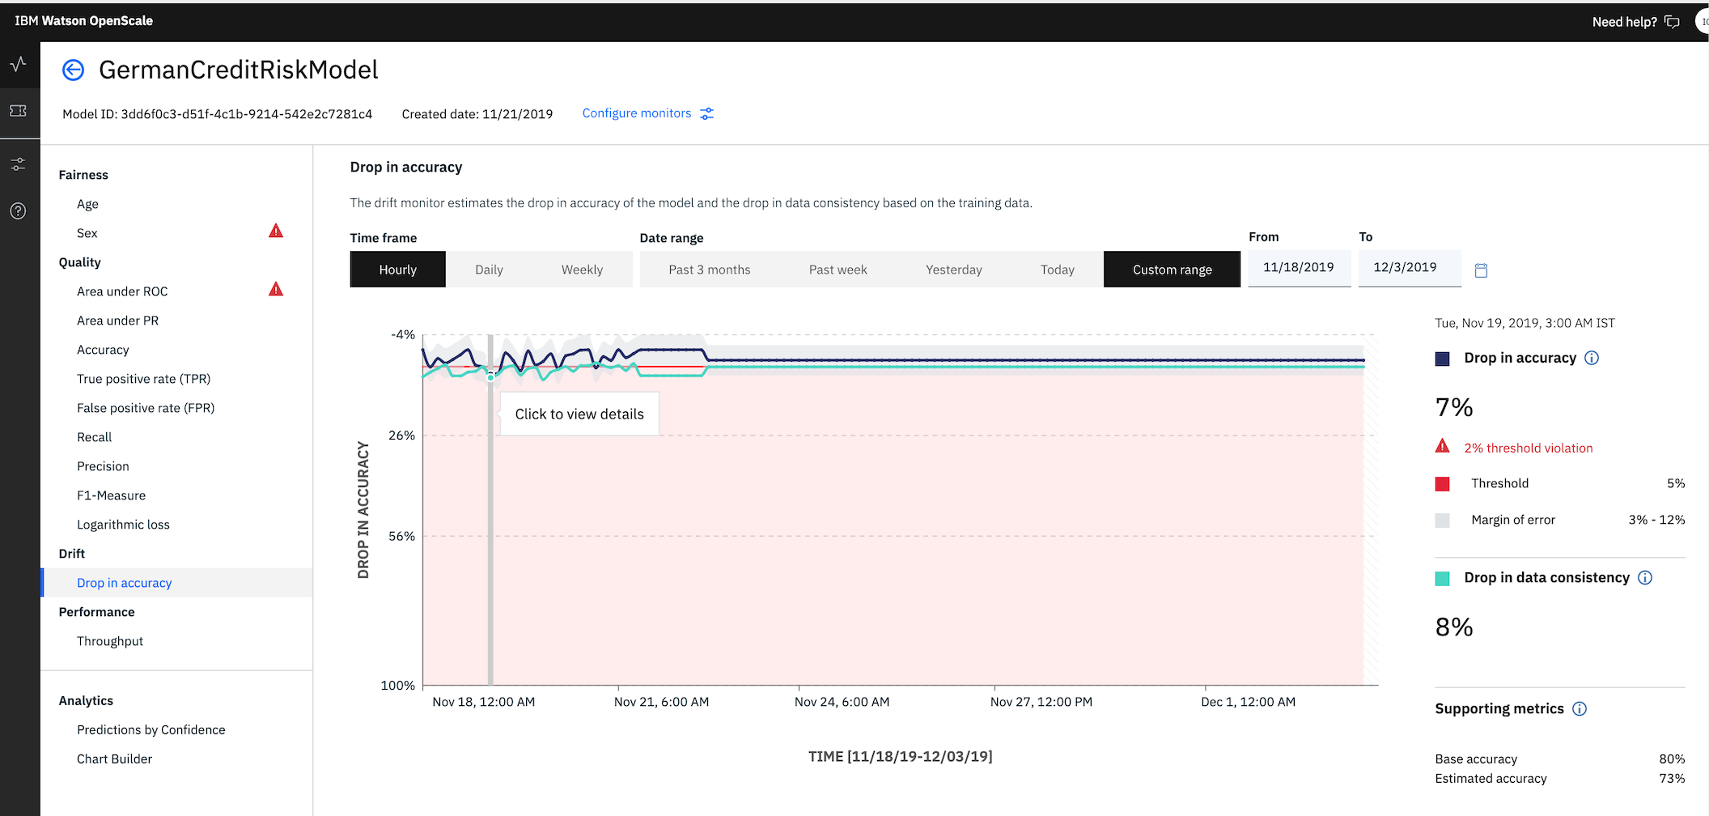
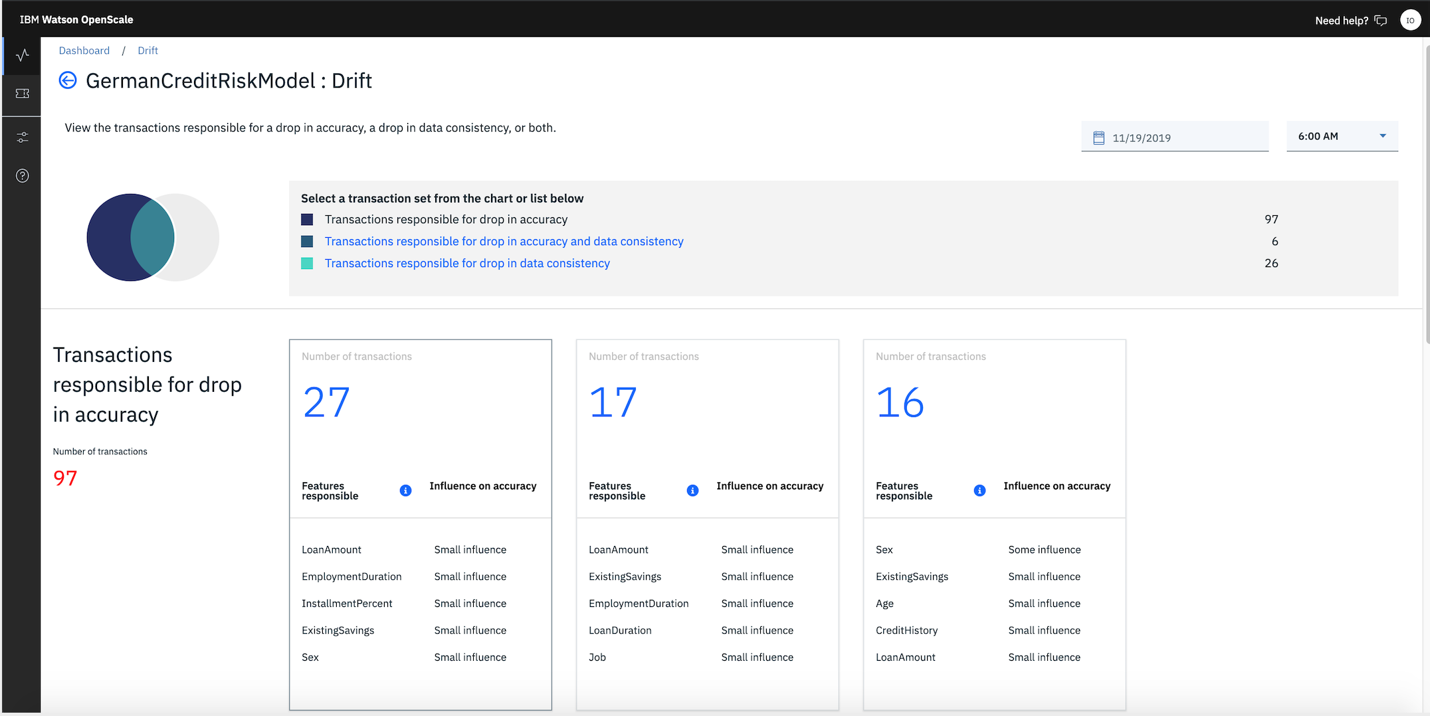
Watson OpenScale will automatically detect drifted transactions and pinpoint datapoints that contribute to drift
Notes:
Align model performance with business outcomes – “if you are thinking about launching an AI model into production, this is a no-brainer”
Ensure that models are resilient to changing situations – “if you are using AI to impact revenue, identify problems with business models or transform operations, you have to track changes in business inputs. Models need to keep up with it much faster than manual review/retrain recommendations”
Prove regulatory compliance and safeguards – “if you are in a regulated industry, there are existing regulations that automated decisions have to meet”; “new controls could get added to GDPR or new regulations being proposed may become a reality in the Digital age”. This will need to be done both during production and before deploying

Slide 16
Emerging use case: Model Risk Management in Financial Services
Problem:
Current risk management practices are not optimized for AI
Open source frameworks not supported
Additional data science skills required for validating AI models
Processes rely on manual interaction between validator and model developer
Current systems focus more on the documentation and workflow aspects of model validation, no active testing
No focus on active production monitoring
Watson OpenScale will automate active testing of models for validation and monitoring and synchronize results with governance platforms

Slide 17
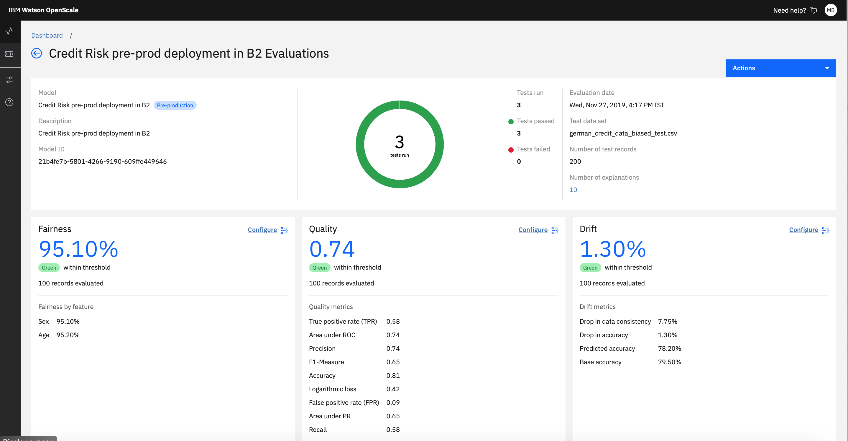

Slide 18
IBM Watson OpenScale + IBM OpenPages
Closed beta
Model Risk Management Solution for Financial Services
IBM OpenPages
Model Risk Governance
Store, manage and monitor a comprehensive model inventory
IBM Watson OpenScale
Active testing for model validation and continuous monitoring
Notes:
OpenPages
Comprehensive model inventory
Model policy and procedures
Model ownership, roles and responsibilities
Configurable workflows
Document and track risk issues
Documentation of model validation test reports from OpenScale
OpenScale
Ongoing health monitoring of AI Models during runtime
Validation Support:
Automatic deployment and execution of validation tests for AI Models
Actionable model validation reports with interpretation of results
Metrics and reports are sent automatically to OpenPages
Notification of issues when quality thresholds or business KPIs are violated
Bias detection and mitigation
Detection of model drift and quality metrics
Trace and explain AI predictions

Slide 19
OpenScale Demo

Slide 20

20

